Slide 1
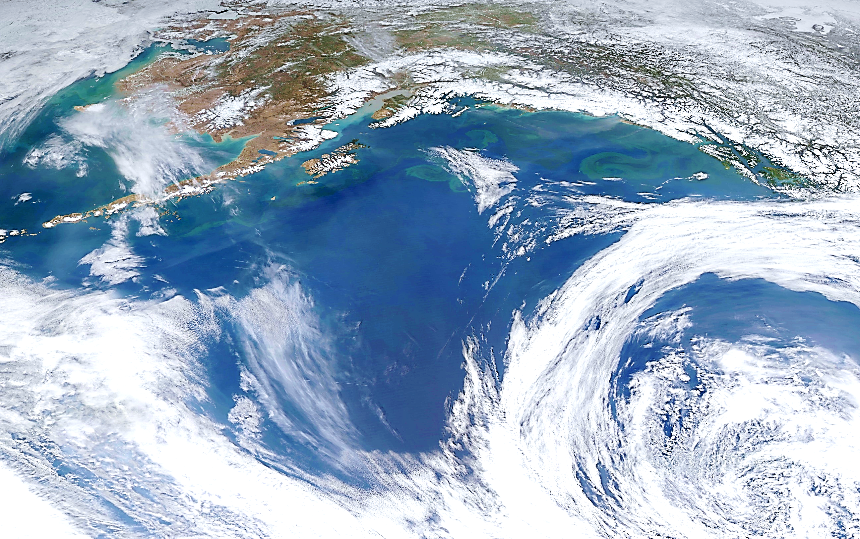
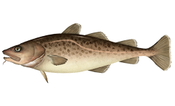
Gulf of Alaska Pacific cod
Steve Barbeaux, Ben Laurel, Mike Litzow, and Ingrid Spies
September 2021

Slide 2
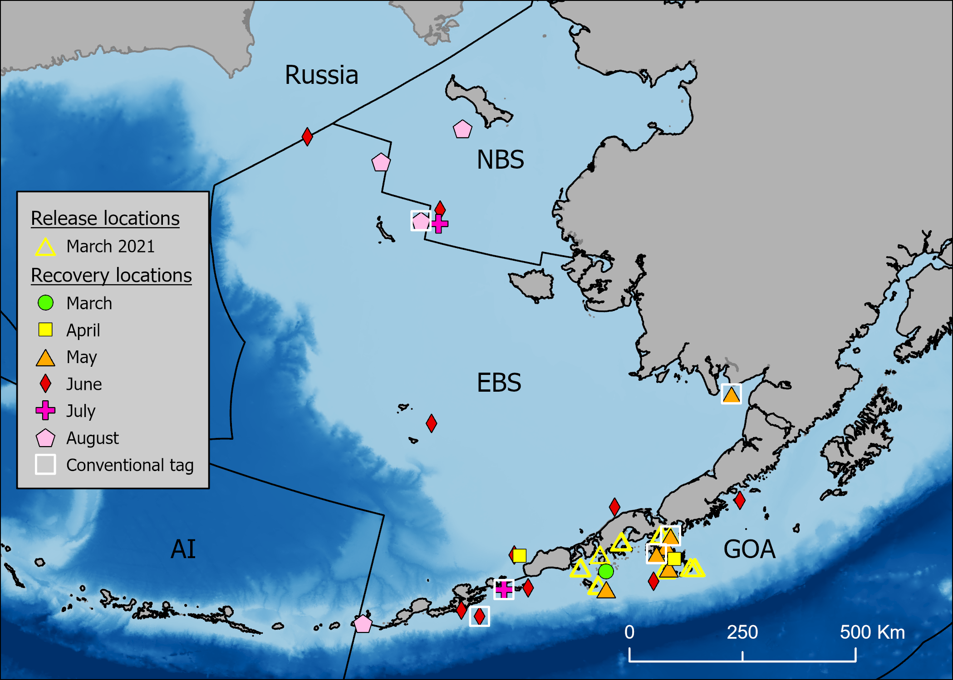
2021 Western Gulf Pacific cod tagging study
Collaboration with Aleutians East Borough
P.I.s:
Susanne McDermott (NOAA)
Wayne Palsson (NOAA)
Steve Barbeaux (NOAA)
Charlotte Levy (Aleutians East Borough)
PACT (Pacific cod tagging team):
Rebecca Haehn (NOAA)
Liz Dawson (NOAA)
Kim Rand (Lynker Technologies)
Julie Nielsen (Kingfisher Marine Research)
Funding:
National Cooperative Research Program (NCRP)
25 satellite tags
957 conventional tags
Shumagin Is. release area
Notes:
Tagging study to determine where cod go from winter spawning grounds in western gulf of Alaska. Assess connectivity between GOA and Bering Sea management areas.
Collaboration with the Aleutians East Borough, funding from the cooperative research program. Worked with local fishers to capture and tag cod.
In March 2021, we released 25 satellite tags and 957 conventional tags in the Shumagin Island area. Map shows recovery (pop-up or vessel recapture) locations through August. During the June – August period, 9 of 16 recoveries were in the Bering Sea. More pop-ups to come (some programmed for 180 and 365 days). Geolocation will reconstruct pathways to determine migration timing and pathways.

Slide 3
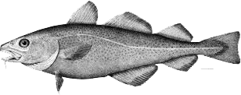
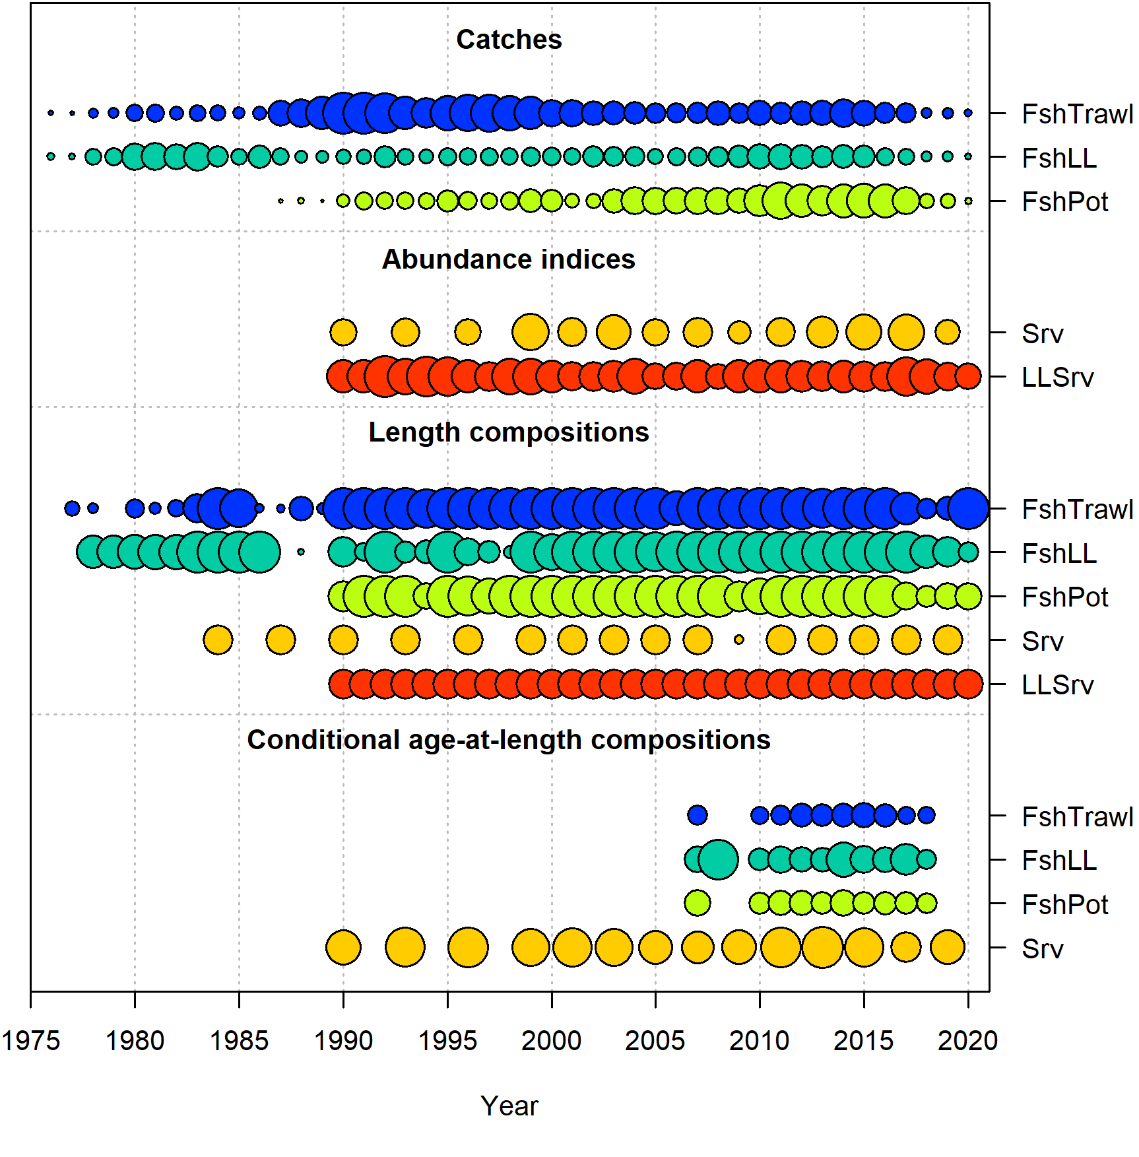
2020 Model 19.1
Fisheries – Longline, Pot, Trawl
Indices – AFSC bottom trawl and AFSC longline surveys
Length composition
All fisheries and indices
Age data
2007+ survey and Fishery conditional age-at-length

Slide 4
2020 Model 19.1
1-20+ age bins, 1-117+cm length bins
M (lognormal prior) and Qs (uninformative prior) fit in model
M fit separately for 2014-2016 block
Beverton-Holt (σ_{R} = 0.44, Steepness = 1.0)
Three-parameter von Bertalanffy growth (informative priors based on 2007-2018 survey age composition data)
Double normal length-based size selectivity for all size composition
Blocks for bottom trawl survey
longline and trawl
pre-1990 annual varying
Blocks for post-1990
Longline survey catchability scaled to CFSR temperatures for 0-10 cm Pacific cod mean depth

Slide 5
Models considered for September 2021
Model name | Data changes from 2020 | Model changes from 2020 | Description
Model 19.1 | None | None | Reference model from 2020
Model 21.1a | Laurel/Litzow larval index | Model 19.1 | Addition of the age-0 index from the Kodiak Beach seine surveys conducted by Laurel and Litzow.
Model 21.1b | Laurel/Litzow larval index | Model 21.1a with Temp.-linked growth | SST-linked growth in model
Model 21.1c | Laurel/Litzow larval index | Model 21.1a with heatwave-linked natural mortality | Heatwave-linked natural mortality
Model 21.1d | Laurel/Litzow larval index | Model 21.1a with heatwave-linked recruitment | Heatwave-linked recruitment in model
Model 21.1e | Laurel/Litzow larval index | Model 21.1a with Temp.-linked growth, and heatwave-linked recruitment and mortality. | All environmental links turned on
Model 21.1g | Laurel/Litzow larval index | Model 21.1e with index tuned to RMSE and length composition tuned using the Francis method | Model 21.1e tuned
Model 21.5a | Laurel/Litzow larval index | Model 21.1e with extended M block 2015- 2020 | Extended heatwave M to include 2015-2020 instead of environmental link
Model 21.5c | Laurel/Litzow larval index | Model 21.35a with index tuned to RMSE and length composition tuned using the Francis method | Model 21.5a tuned

Slide 6
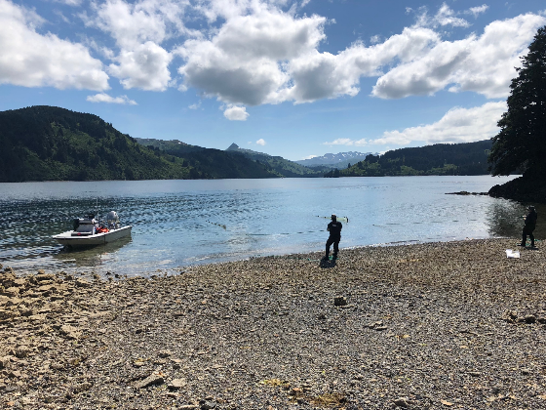
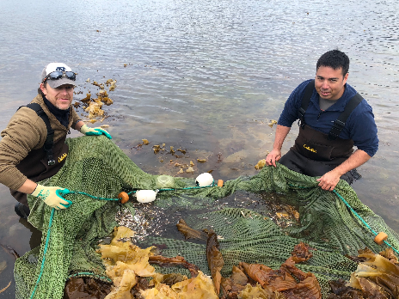
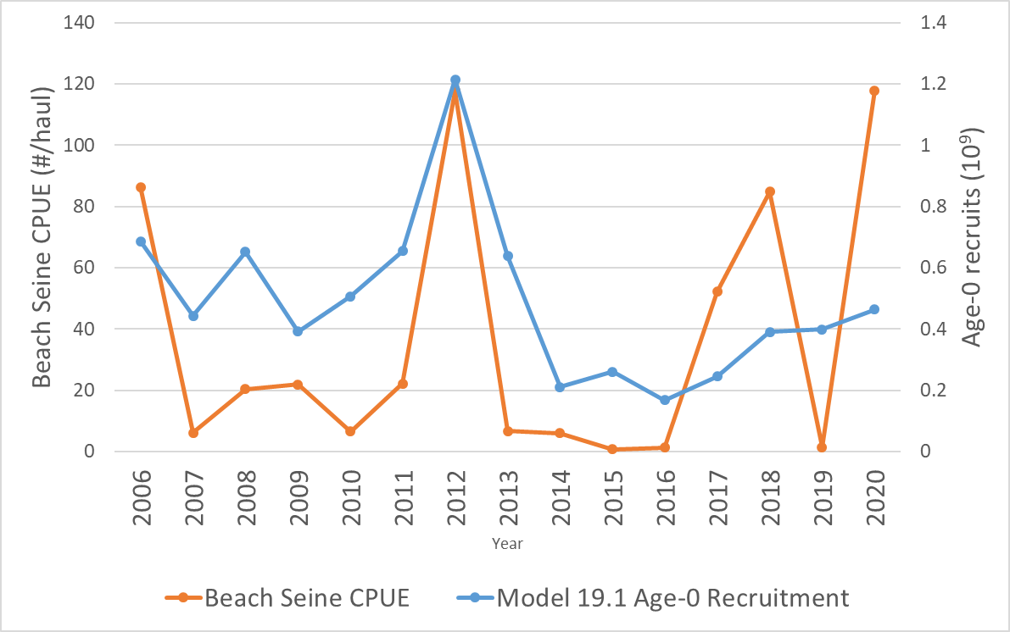
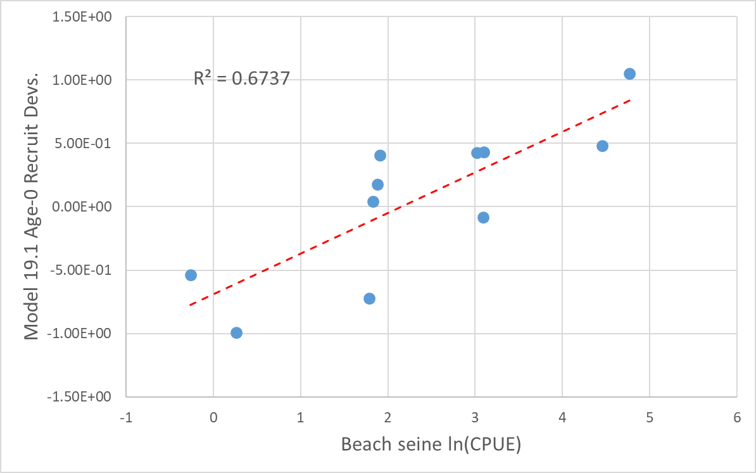
Age-0 Pacific cod beach seine index
2006-2020 Model 19.1
Recruitment vs Beach Seine CPUE
2006-2016 Model 19.1
Recruitment Devs. vs ln(Beach Seine CPUE)

Slide 7
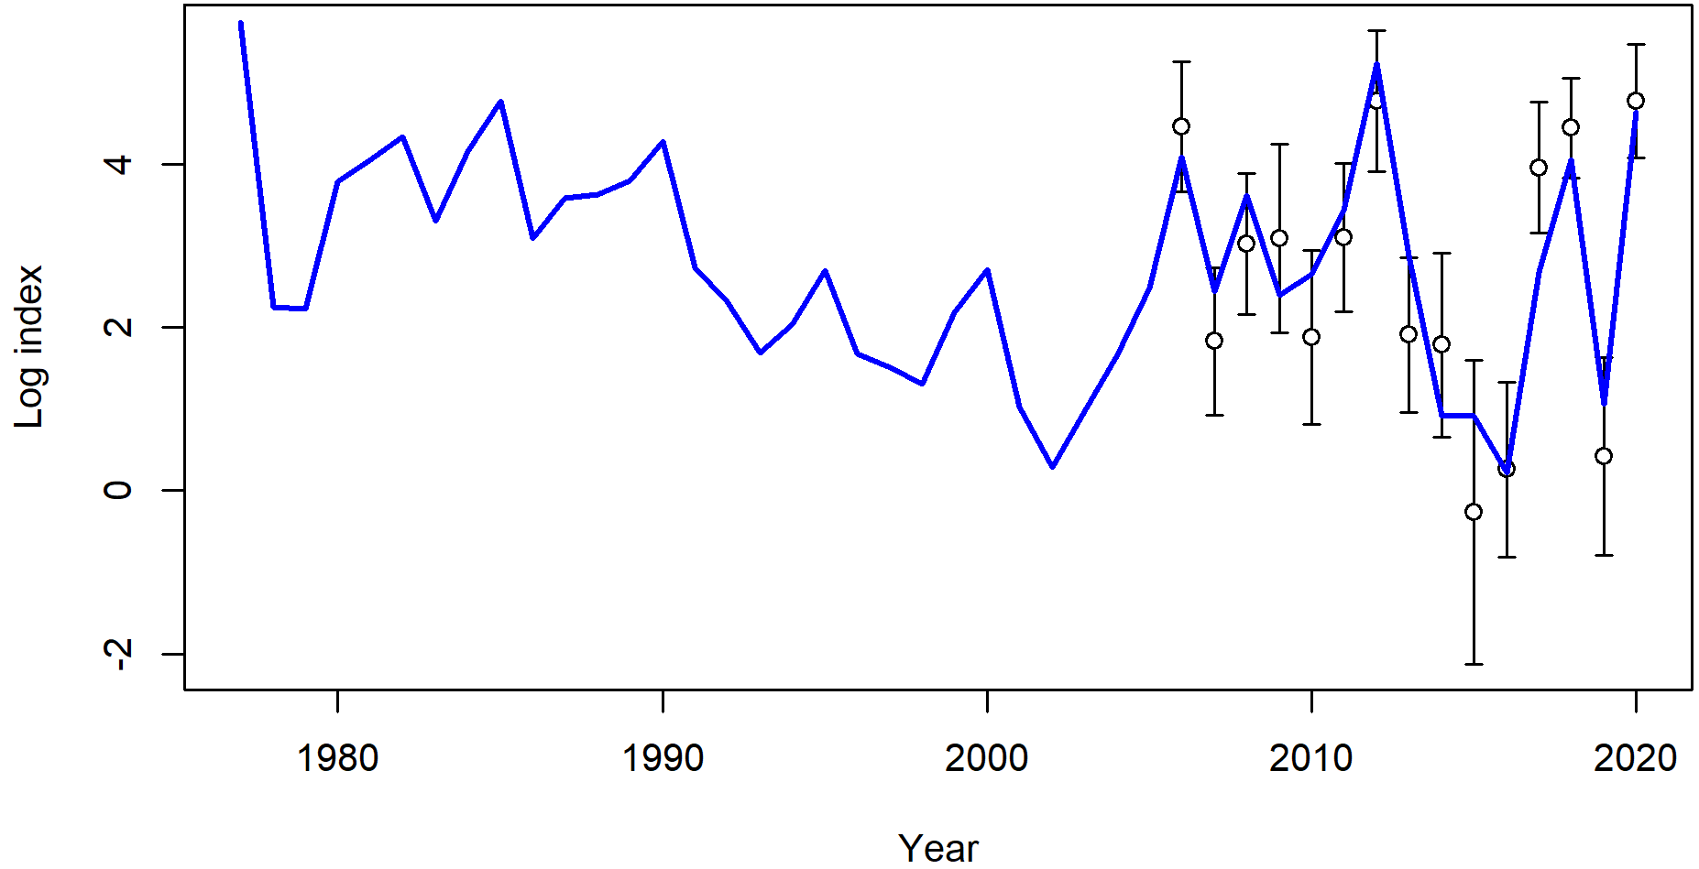
Model 21.1a vs. Model 19.1
Addition of Age-0 beach seine index
Good fit to beach seine index

Slide 8
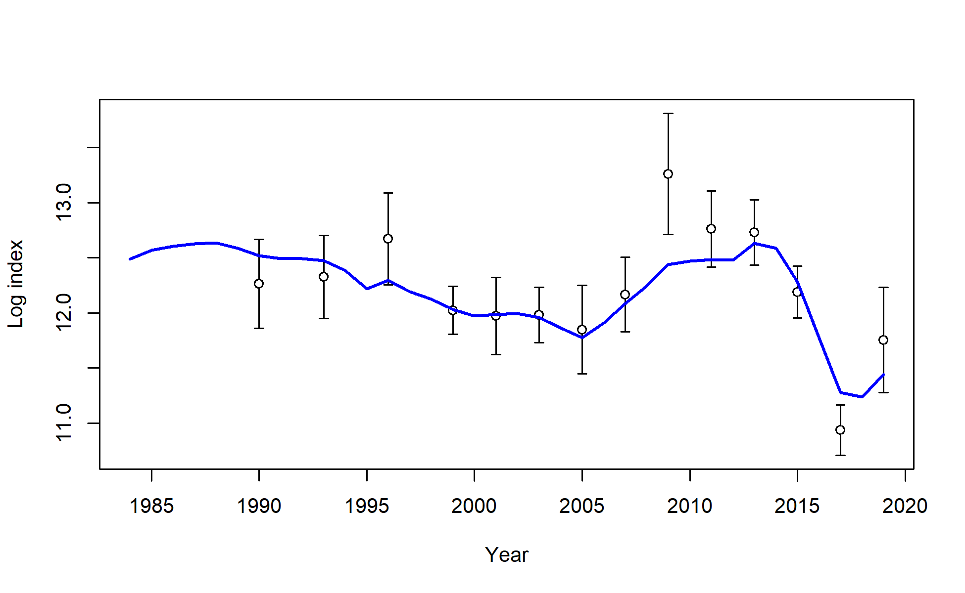
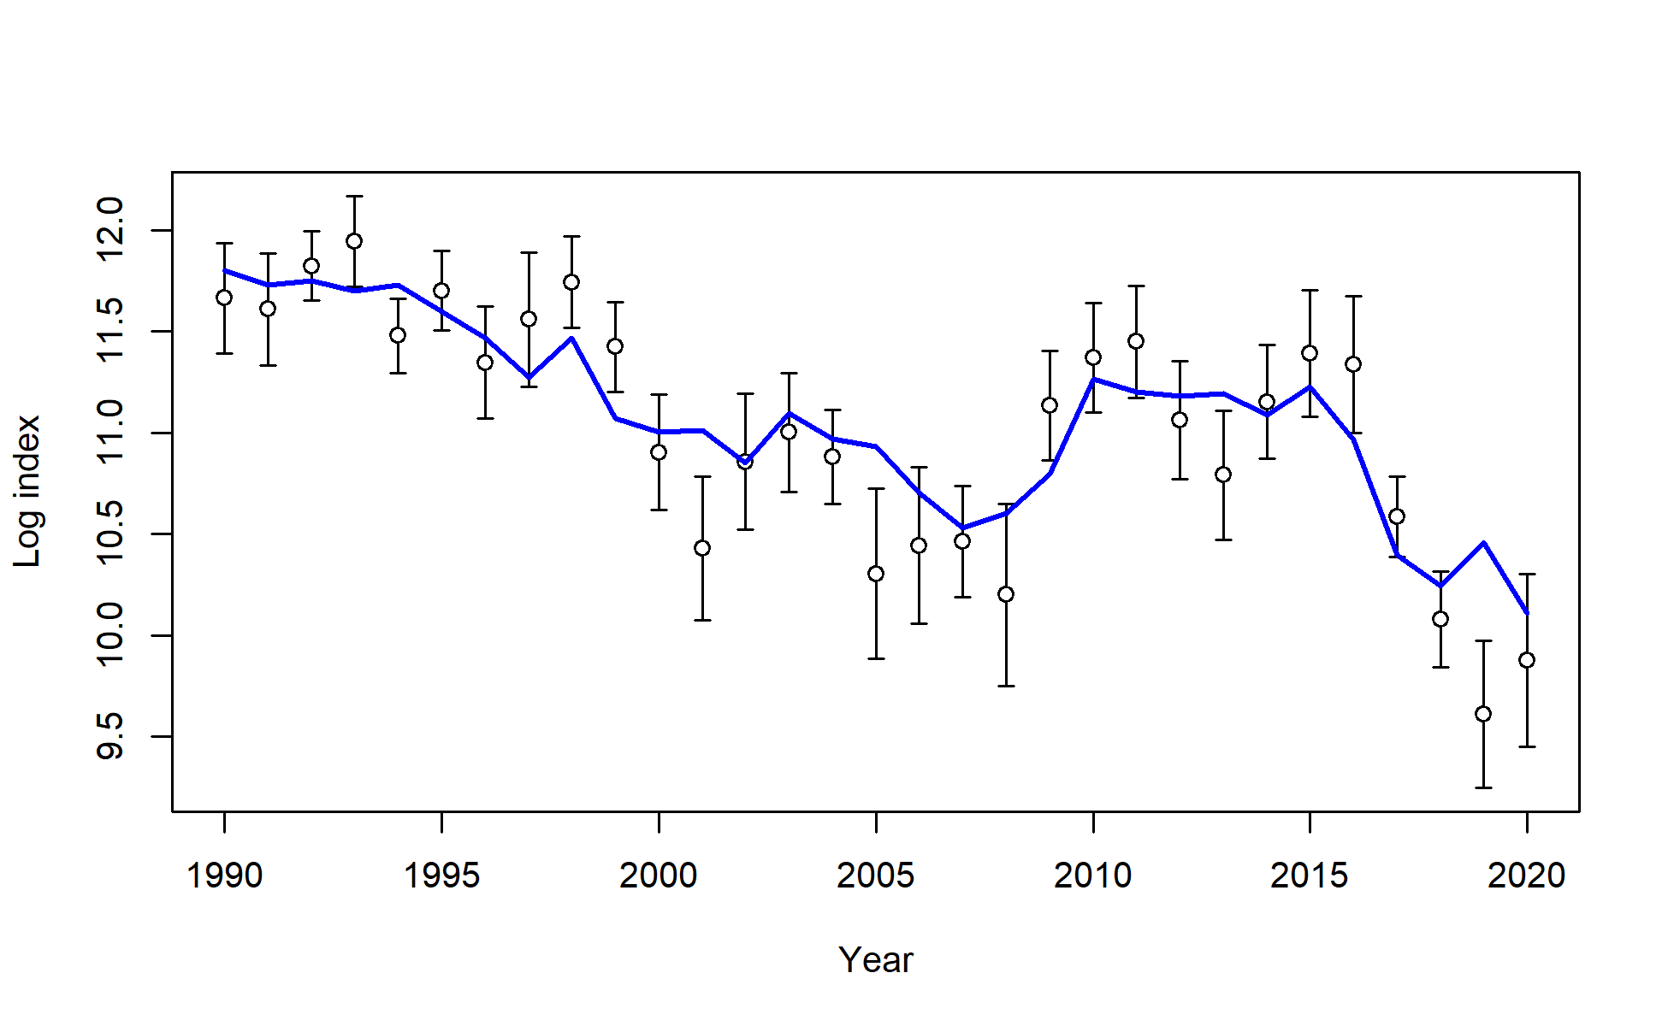
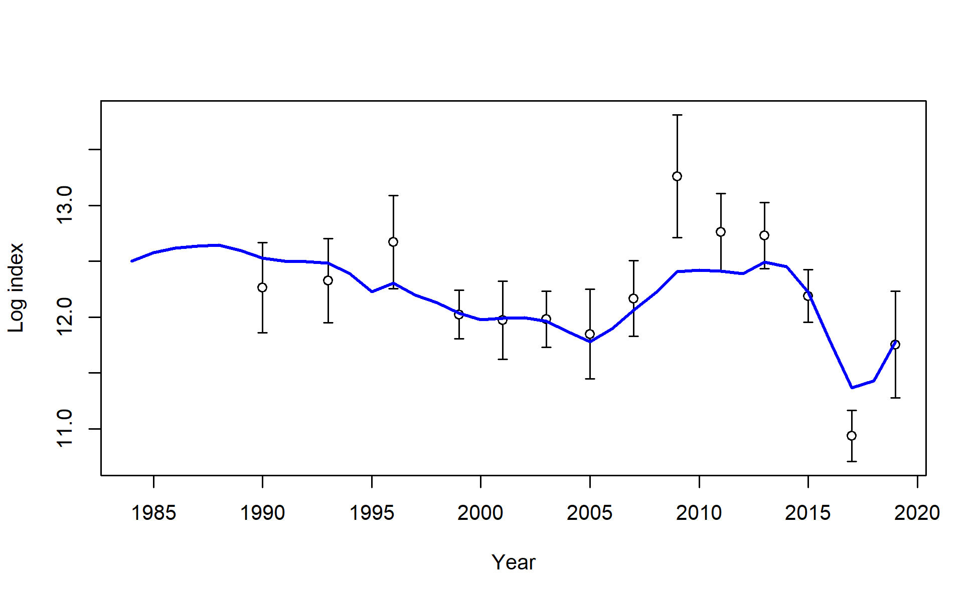

Model 21.1a vs. Model 19.1
Addition of Age-0 beach seine index
Good fit to beach seine index
Poorer fit to all other survey indices
Bottom Trawl Survey Index
Longline Survey Index
Model19.1
Model21.1a

Slide 9
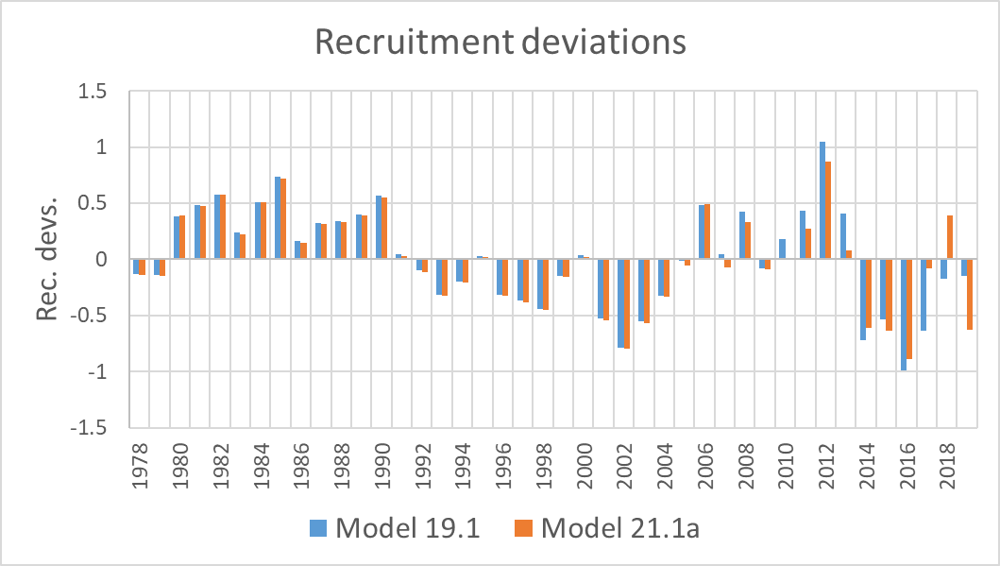
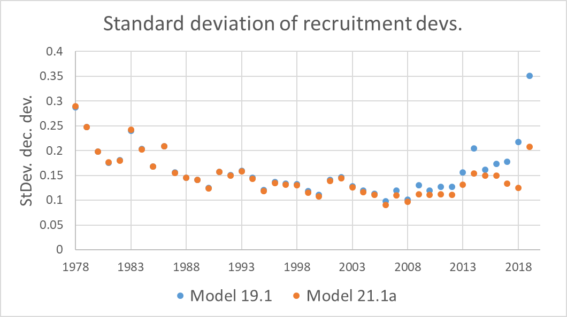
Model 21.1a vs. Model 19.1
Addition of Age-0 beach seine index
Good fit to beach seine index
Poorer fit to all other survey indices
Reduced rec. devs. and variance of rec. devs.
Reduced variance on reference points
Reduction in heatwave block M from 0.82 to 0.75
Mixed results for composition fits
Retrospective Rho’s and RMSE remain close to the same

Slide 10

New environmental links
Growth
June CFSR temps for 0-20 cm cod
Larval growth index based on June CFSR temps
Mortality
Annual heatwave index
Recruitment
Spawning heatwave index

Slide 11
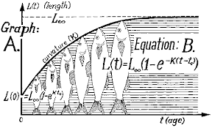
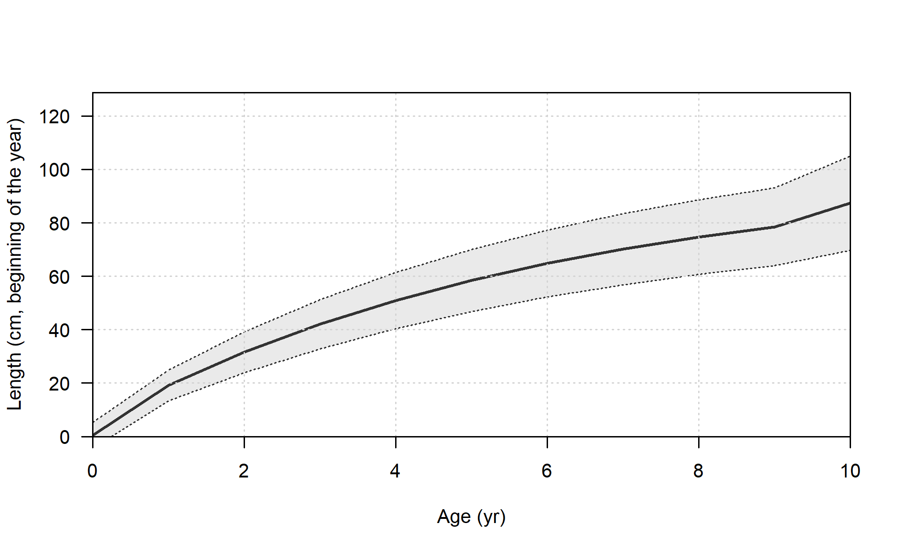
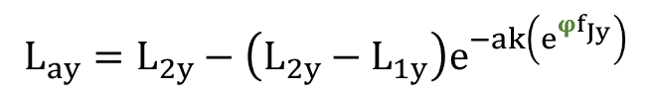
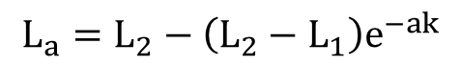
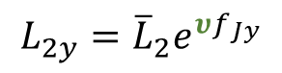
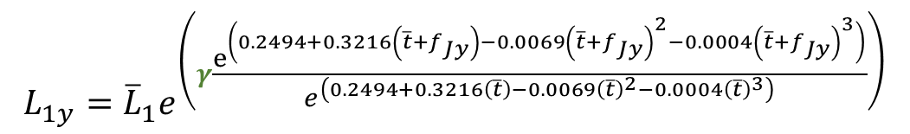
Growth
Model 19.1 standard Stock Synthesis von Bertalanffy
June temp. anomaly-linked von Bertalanffy with Laurel et al. (2015) larval growth index
$$L_{a}={L_{2}−\left(L_{2}−L_{1}\right)e}^{−ak}$$
$$L_{ay}={L_{2y}−\left(L_{2y}−L_{1y}\right)e}^{−ak\left(e^{{φf}_{Jy}}\right)}$$
$$L_{1y}={\overline{L}}_{1}e^{\left(γ\frac{e^{\left(0.2494+0.3216\left(\overline{t}+f_{Jy}\right)−0.0069{\left(\overline{t}+f_{Jy}\right)}^{2}−0.0004{\left(\overline{t}+f_{Jy}\right)}^{3}\right)}}{e^{\left(0.2494+0.3216\left(\overline{t}\right)−0.0069{\left(\overline{t}\right)}^{2}−0.0004{\left(\overline{t}\right)}^{3}\right)}}\right)}$$
$$L_{2y}={\overline{L}}_{2}e^{υf_{Jy}}$$

Slide 12
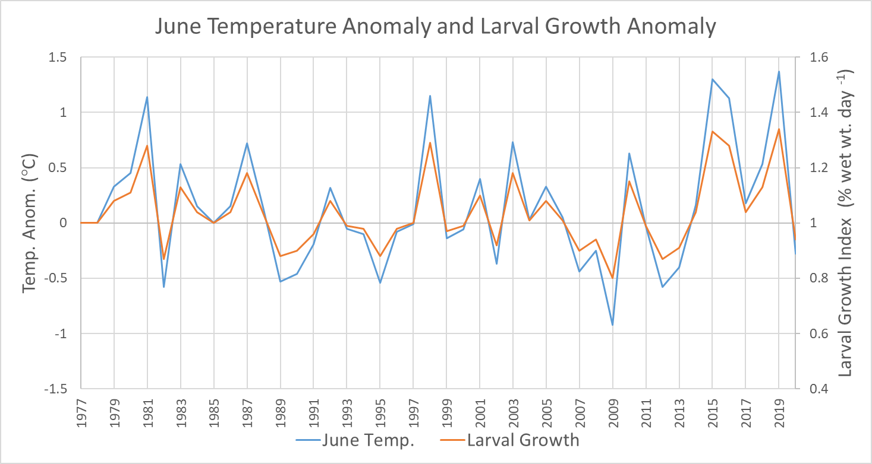

Slide 13
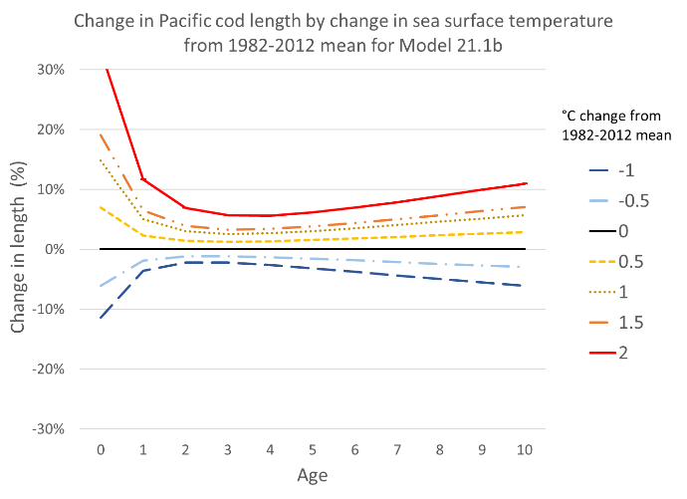
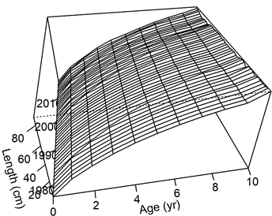
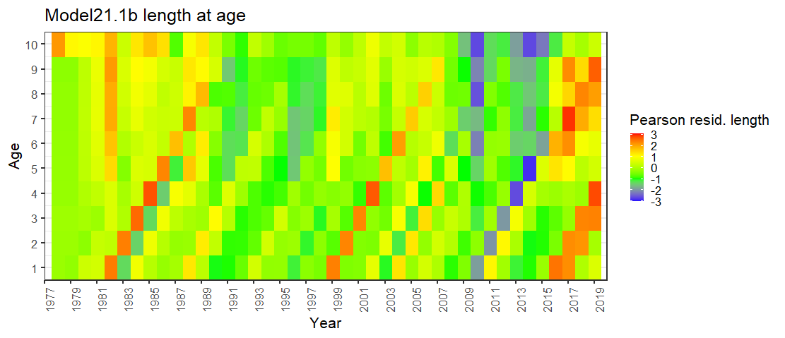

Slide 14

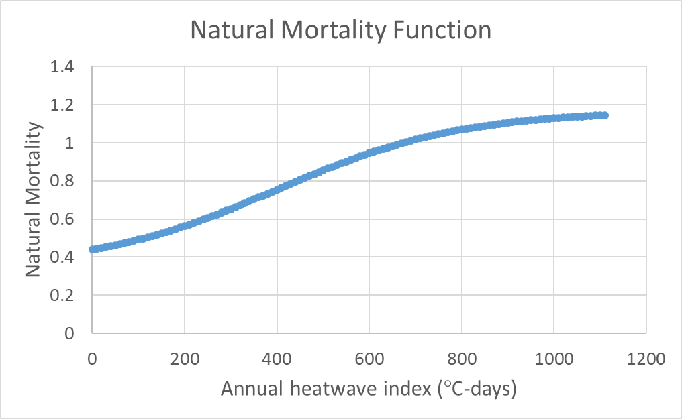
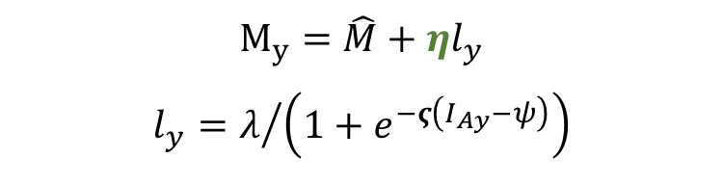
Natural Mortality
Model 19.1, 21.1a, 21.1b,and 21.1d: separate block for 2014-2016
Model 21.1c, 21.1e, and 21.1g: annual heatwave linked natural mortality with asymptote
Logistic function fit iteratively
λ = 0.65
ς = 0.05
ψ = 400
$$M_{y}=\hat{M}+ηl_{y}$$
$$l_{y}=λ/{\left(1+e^{−ς\left(I_{Ay}−ψ\right)}\right)}$$
Logistic function for asymptotic M

Slide 15
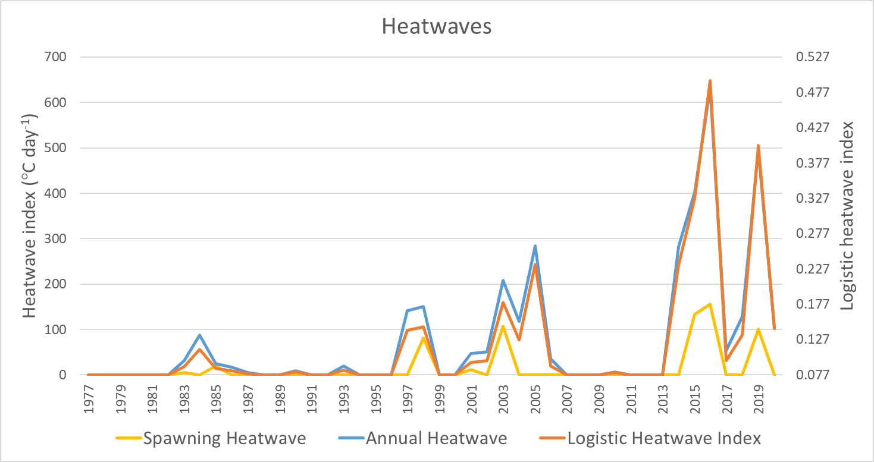
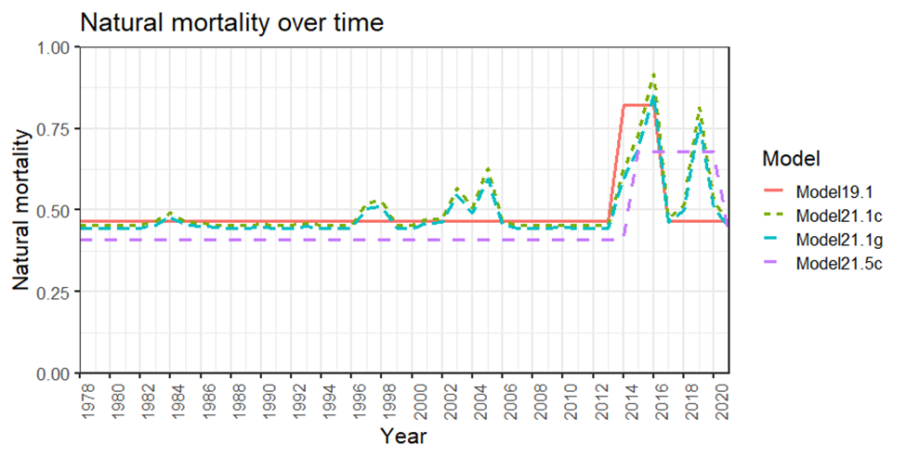
Natural Mortality
Model 21.5 series
Iteratively fit annual natural mortality
Best fit model with lowest objective value had a separate block for 2015-2020

Slide 16
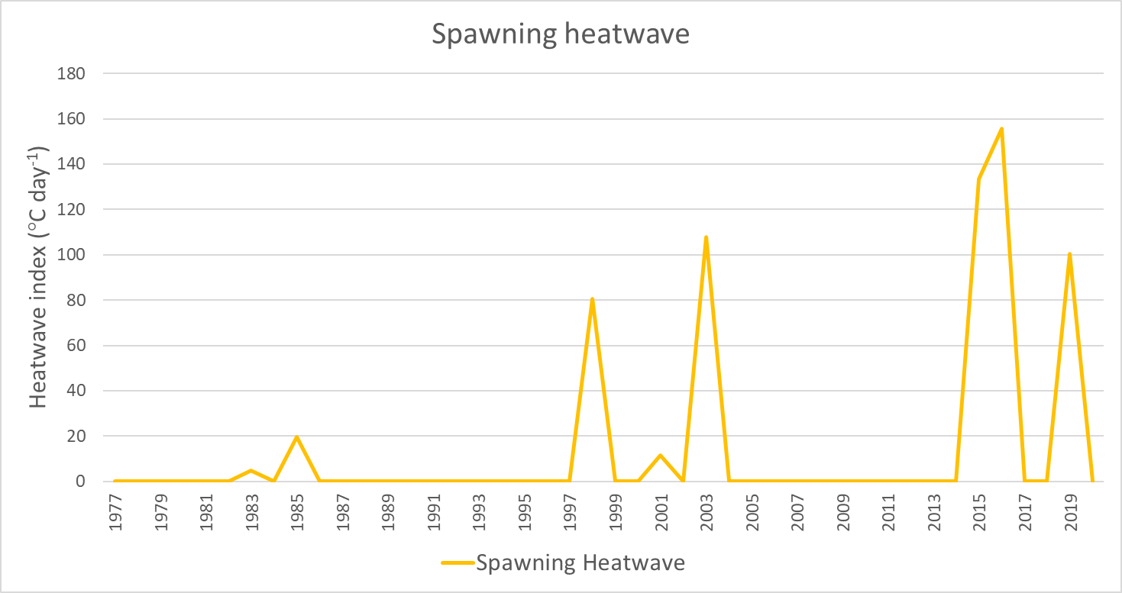
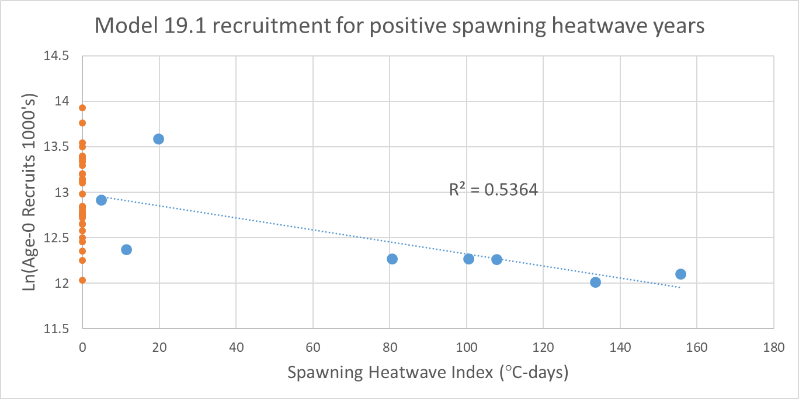
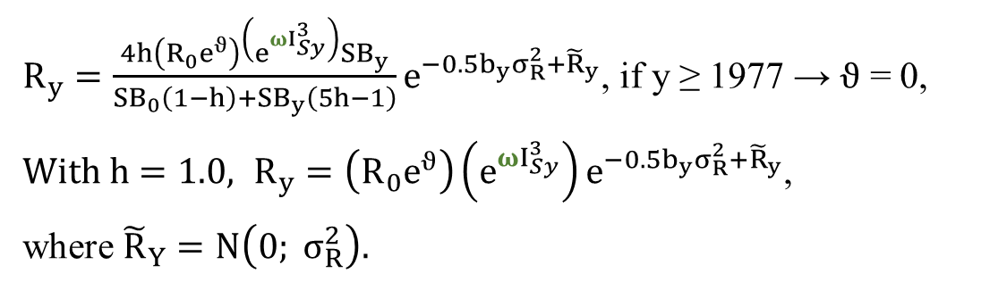
Recruitment
Standard Tier 3 recruitment
Spawning heatwave-linked recruitment
$R_{y}=\left(R_{0}e^{ϑ}\right)e^{−0.5b_{y}σ_{R}^{2}+{\tilde{R}}_{y}}$ , if y ≥ 1977 → $ϑ$ = 0, where ${\tilde{R}}_{y}=N\left(0; σ_{R}^{2}\right)$
$R_{y}=\frac{4h\left(R_{0}e^{ϑ}\right)\left(e^{ωI_{Sy}^{3}}\right){SB}_{y}}{{SB}_{0}\left(1−h\right)+{SB}_{y}\left(5h−1\right)}e^{−0.5b_{y}σ_{R}^{2}+{\tilde{R}}_{y}}$, if y ≥ 1977 → $ϑ$ = 0,
${With h=1.0, R}_{y}=\left(R_{0}e^{ϑ}\right)\left(e^{ωI_{Sy}^{3}}\right)e^{−0.5b_{y}σ_{R}^{2}+{\tilde{R}}_{y}}$,
where ${\tilde{R}}_{Y}=N\left(0; σ_{R}^{2}\right).$

Slide 17
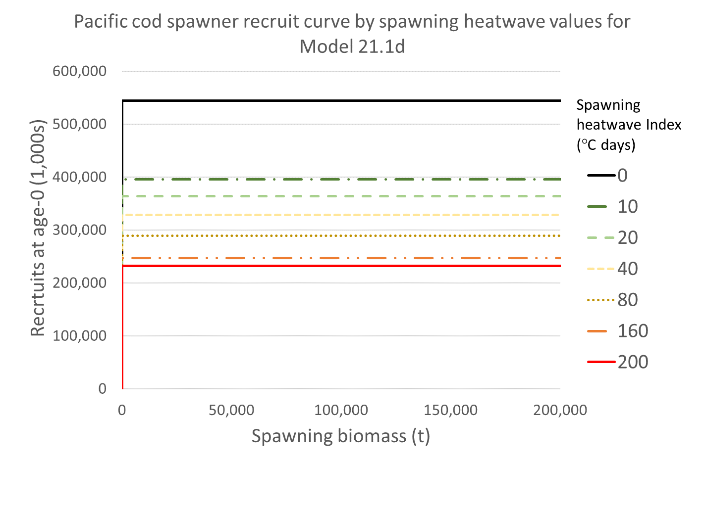
Recruitment

Slide 18

Model tuning
Indices
Standard Error + adjustment tuned to RMSE
Age and length sample size
Francis 1A.18 method as implemented in R4SS
Reduced sample size for all composition data
Tuning results
All data components were given higher variance/lower sample size
Increased emphasis on model structure and priors
More weight on indices with slight overfitting based on RMSSR < 1.0
Additional tuning of indices necessary

Slide 19
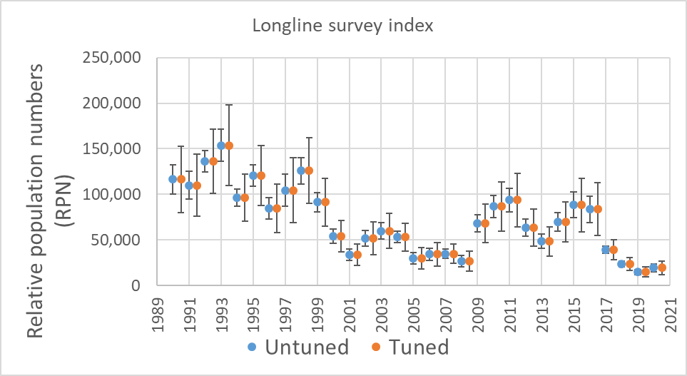
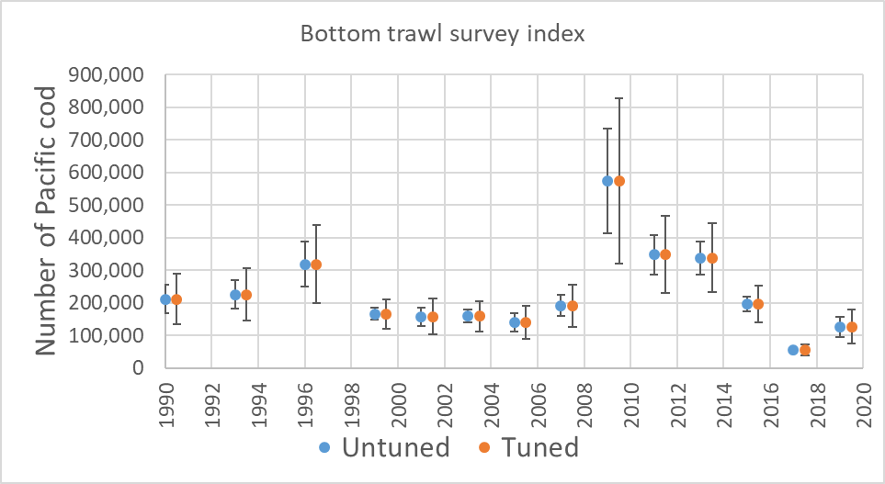
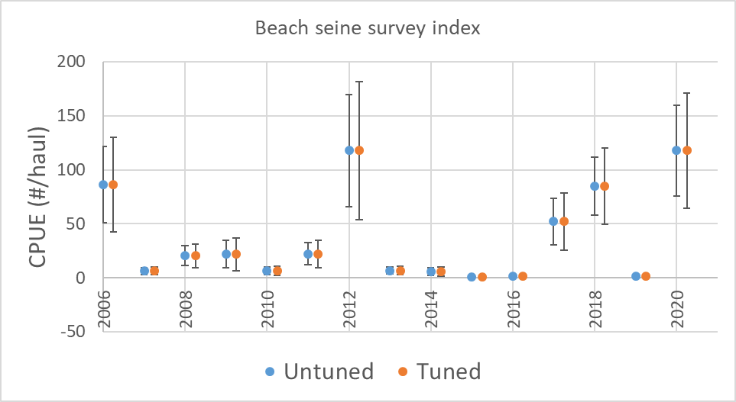
Model tuning
Component |  | Tuning | Model 21.1g | Model 21.5c
Index | Beach seine survey | add_to_survey_CV | 0.100 | 0.100
 | Bottom trawl survey | add_to_survey_CV | 0.162 | 0.162
 | Longline survey | add_to_survey_CV | 0.171 | 0.171
Length | Trawl fishery | mult_by_lencomp_N | 0.256 | 0.257
 | Longline fishery | mult_by_lencomp_N | 0.417 | 0.423
 | Pot fishery | mult_by_lencomp_N | 0.156 | 0.152
 | Bottom trawl survey | mult_by_lencomp_N | 0.432 | 0.420
 | Longline survey | mult_by_lencomp_N | 0.403 | 0.412
Age | Trawl fishery | mult_by_agecomp_N | 0.511 | 0.532
 | Longline fishery | mult_by_agecomp_N | 0.572 | 0.577
 | Pot Fishery | mult_by_agecomp_N | 0.346 | 0.358
 | Bottom trawl survey | mult_by_agecomp_N | 0.196 | 0.192

Slide 20

Model evaluation
 |  |  |  |  |  |  | Retrospective analysis (SSB)
 | Attributes | # Parameters | -Log likelihood | AIC | -Marginal log likelihood | Marginal AIC | ρ | Woodshole ρ | RMSE
Model 19.1 |  | 201 | 3,190.0 | 6,782.0 | 3,356.6 | 7,115.3 | 0.081 | 0.085 | 0.152
Model 21.1 |  | 202 | 3,210.5 | 6,825.1 | 3,368.7 | 7,139.3 | 0.087 | 0.071 | 0.162
Model 21.1b | G | 204 | 3,202.8 | 6,813.7 | 3,372.1 | 7,152.3 | 0.129 | 0.080 | 0.178
Model 21.1c | Mh | 201 | 3,194.1 | 6,790.2 | 3,352.2 | 7,106.4 | 0.101 | 0.063 | 0.159
Model 21.1d | R | 203 | 3,205.1 | 6,816.1 | 3,368.7 | 7,141.5 | 0.086 | 0.067 | 0.145
Model 21.1cd | R, Mh | 202 | 3,191.1 | 6,786.1 | 3,354.8 | 7,113.6 | 0.104 | 0.054 | 0.151
Model 21.1e | G, R, Mh | 205 | 3,182.1 | 6,774.2 | 3,356.3 | 7,122.6 | 0.164 | 0.072 | 0.183
Model 21.1g | G, R, Mh, T | 205 | 2,039.6 | 4,489.2 | 2,149.1 | 4,708.2 | 0.164 | 0.120 | 0.198
Model 21.5a | G,R,M20 | 205 | 3,168.7 | 6,747.4 | 3,343.6 | 7,097.2 | 0.132 | 0.121 | 0.223
Model 21.5c | G,R,T | 205 | 2,036.4 | 4,482.9 | 2,149.8 | 4,709.5 | -0.047 | -0.015 | 0.078

Slide 21

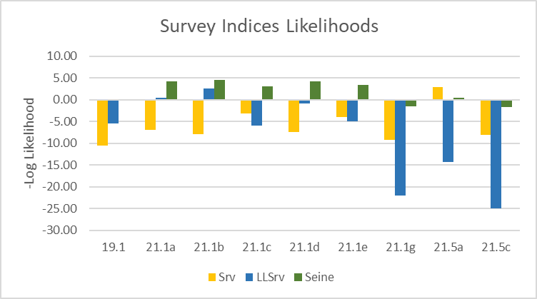
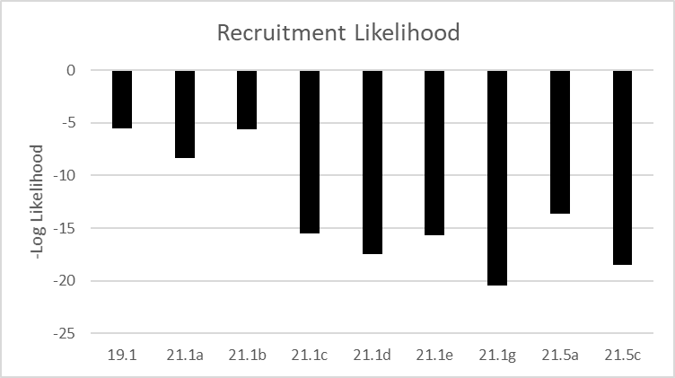
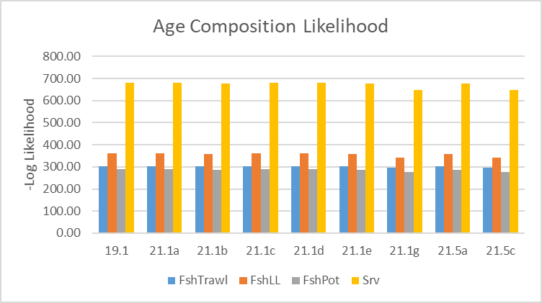
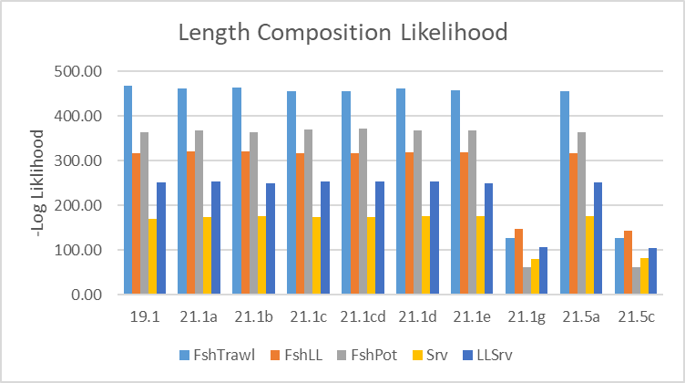
Likelihood components
=Tuned models

Slide 22
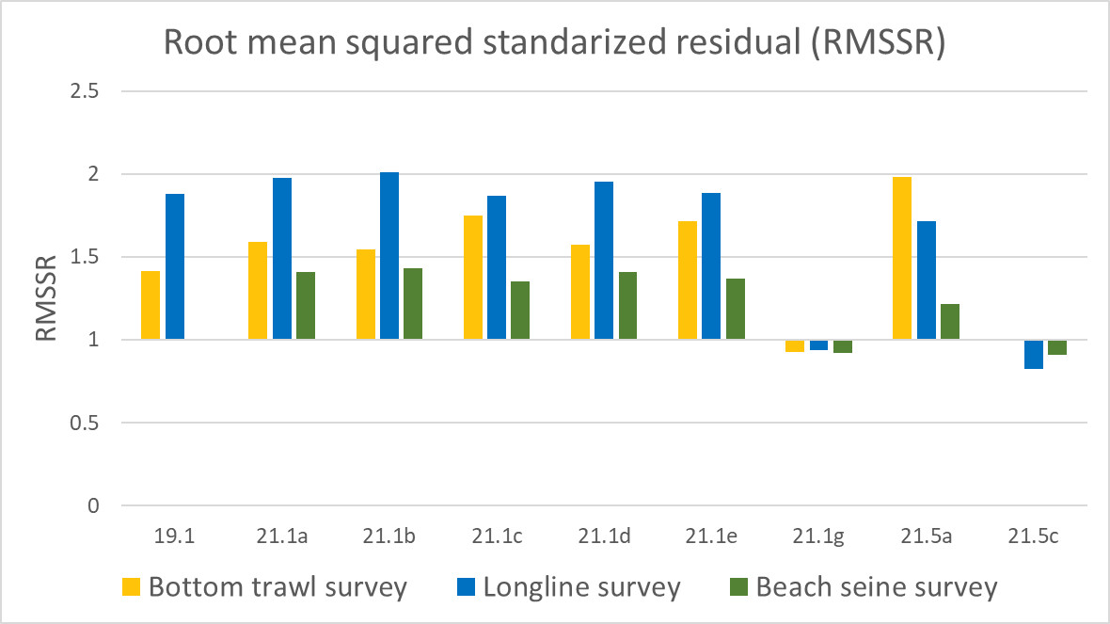
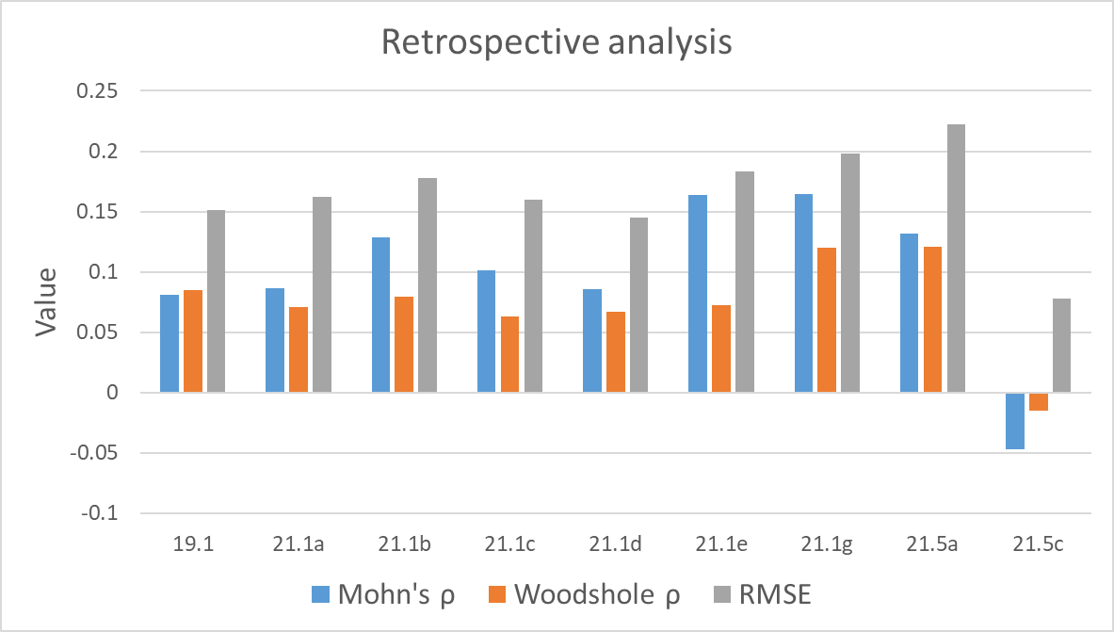
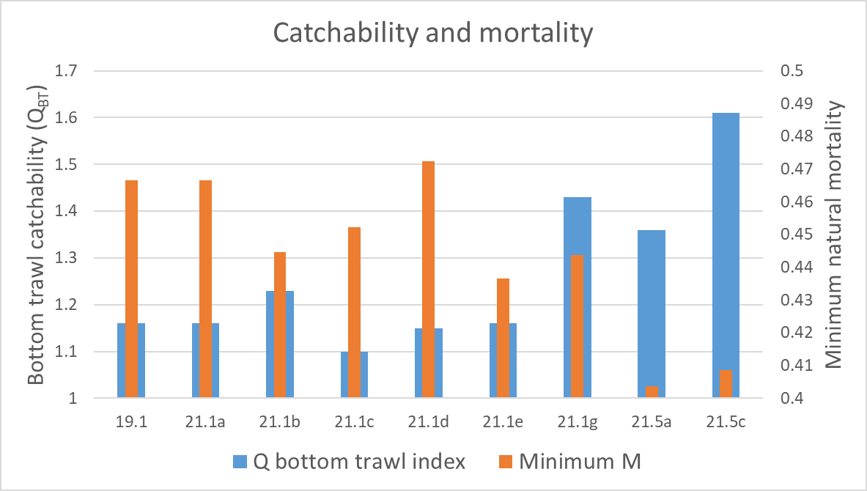
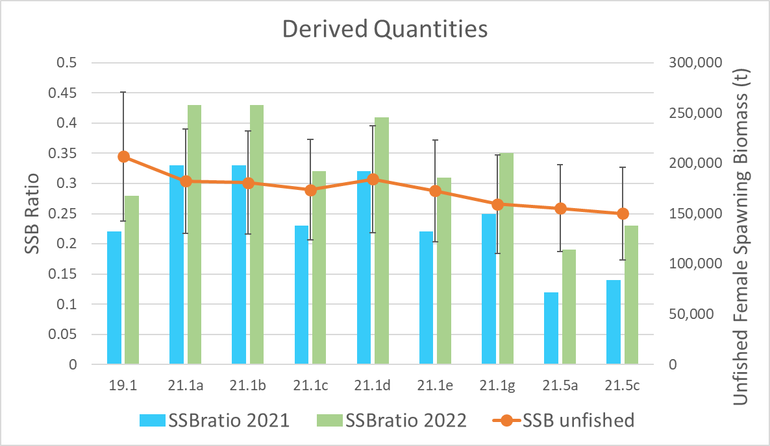
Model evaluation
=Tuned models

Slide 23
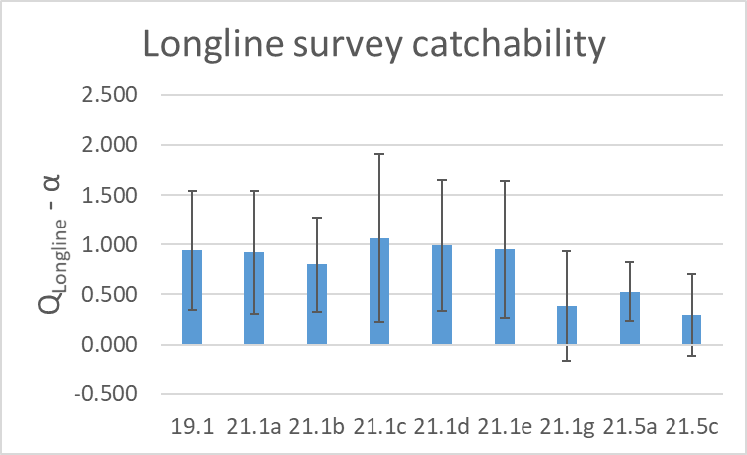
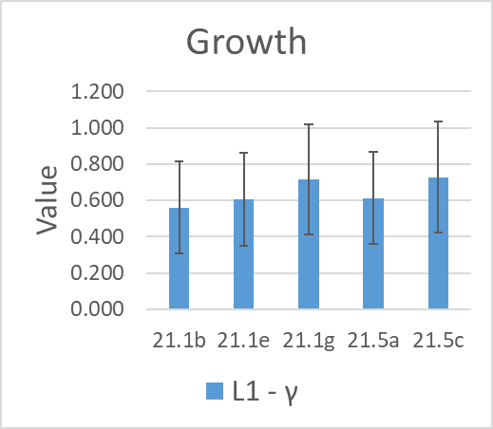
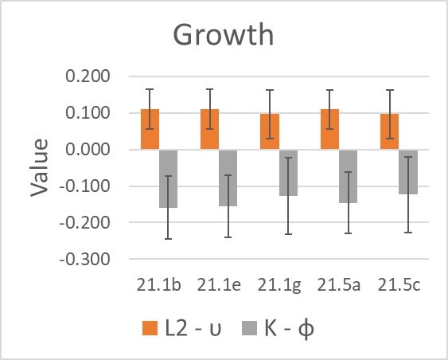
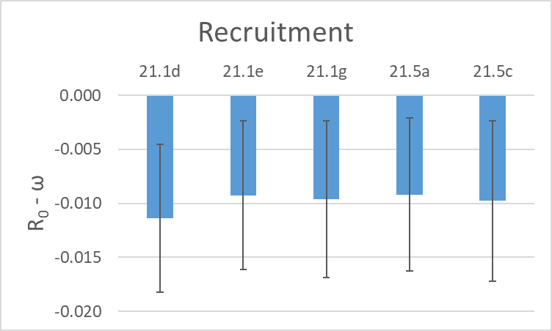
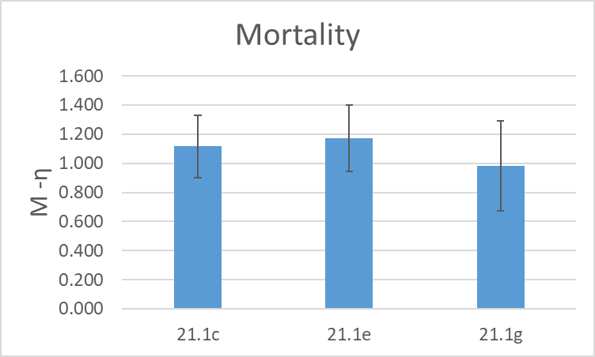
Model evaluation Environmental-link parameters
=Tuned models

Slide 24
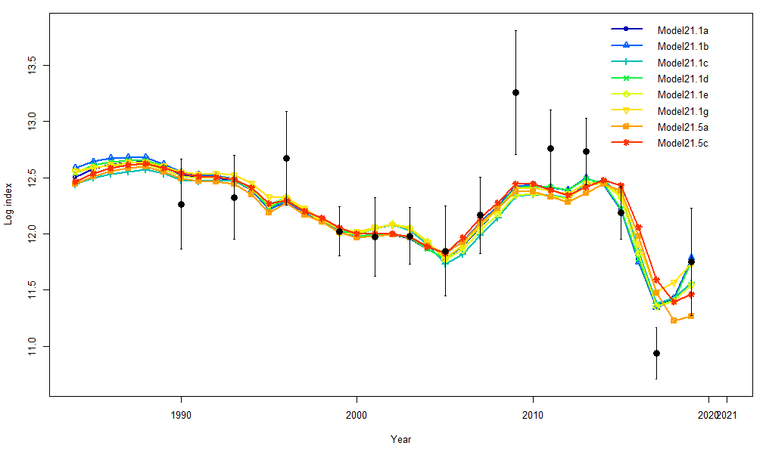


Models 21.1 and 21.5 series fits to indices
Bottom trawl survey
Longline survey
Beach seine survey

Slide 25


Model 21.1 and 21.5 series results

Slide 26


Model 21.1 and 21.5 series results

Slide 27

Summary
Adding the age-0 beach seine index reduced recruitment variability and variability of reference points while degrading fit to other indices
All Un-tuned 21.1 series models performed adequately
Tuned models and 21.5 series models had high survey catchability
Small changes in ecological linkages or weighting led to large changes in management advice
*
* Below B_{20%}

Slide 28

New Data to be added for November
2021 Observer fishery length composition data
2019-2020 observer fishery age data
2021 ADF&G port sampling fish length composition
2021 Bottom trawl survey and length composition
2021 Longline survey index and length composition
2021 Beach seine survey age-0 index

Slide 29

Proposed models for November
Model 19.1
Base model
Model 21.1e
Growth, mortality, and recruitment eco-linked
Model 21.1g
Growth, mortality, and recruitment eco-linked
Retuned (RMSSR to 1.0, Francis 1A.18 for composition/Dirichlet)
Model 21.5c
Growth and recruitment eco-linked
Mortality block iteratively re-explored with new data
Retuned (RMSSR to 1.0, Francis 1A.18 for composition/Dirichlet)
Model 21.6 – (Tuned Model21.1a)
Base model
Beach seine index
Retuned (RMSSR to 1.0, Francis 1A.18 for composition/Dirichlet)

Slide 30
November model evaluation?
What specifically does the Team want to see for model selection?
Model fit criteria (likelihood, RMSSR, etc…)
Retrospective analysis
Key parameter estimates and variance
Leave-one-out analyses (variability in key parameters)?

Slide 31






2021 Fishery Performance (if time allows)

Slide 32

Vessels participating in GOA Pacific cod fishery
State and federal
fisheries

Slide 33



2021 GOA Pacific cod fishery performance

Slide 34


2021 GOA Pacific cod fishery
CPUE by gear

Slide 35


Bycatch of Pacific cod in the GOA pollock fishery

Slide 36




Bycatch of Pacific cod in other GOA fisheries
1

Slide 37




Pacific cod condition in the GOA longline and pot fisheries

